Slide 1


Taurus Training Presentation

Slide 2
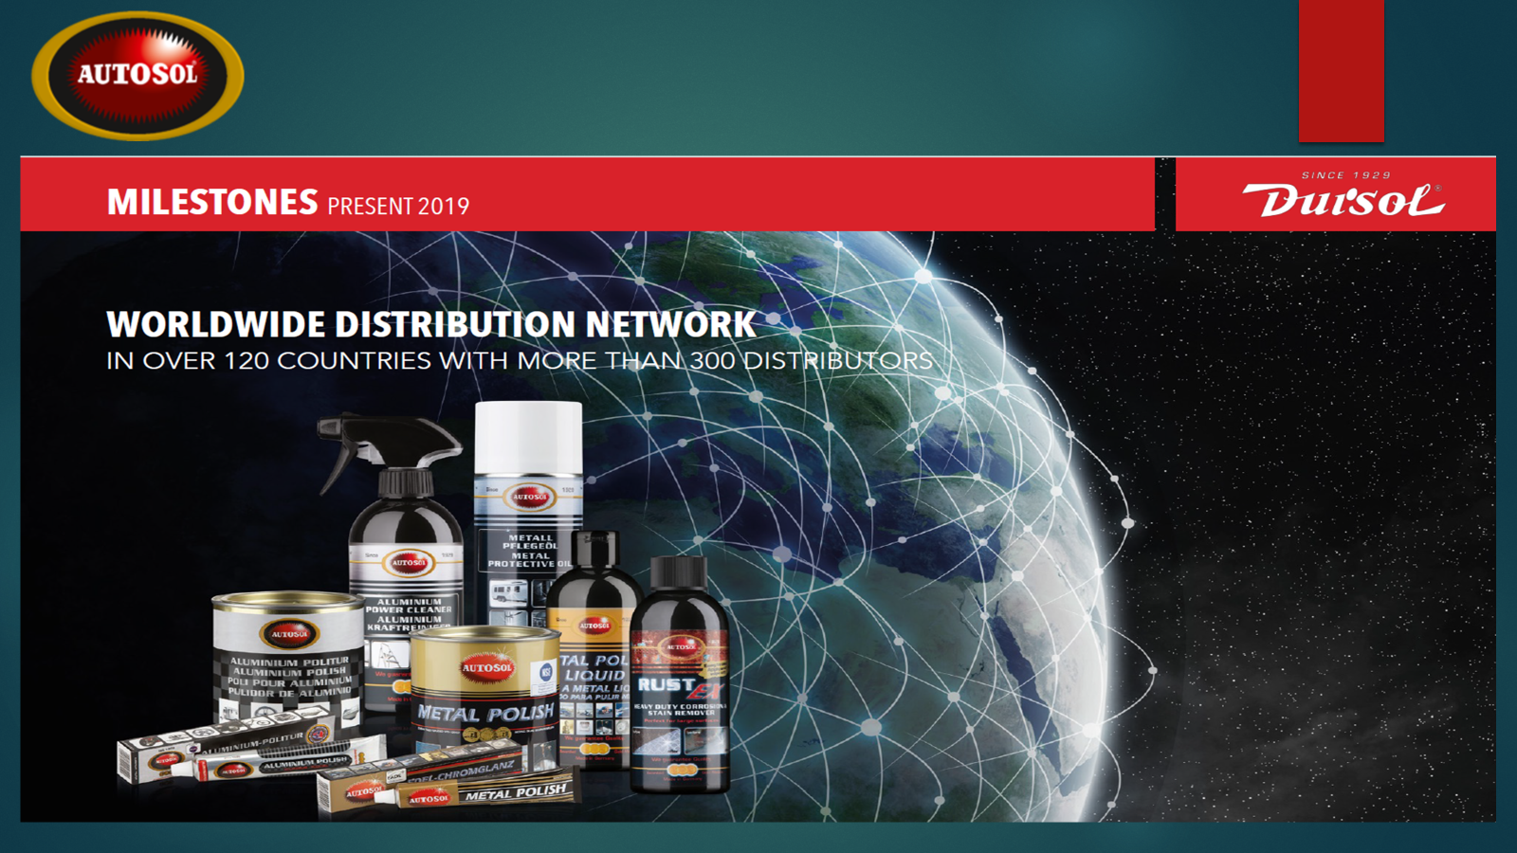

Slide 3

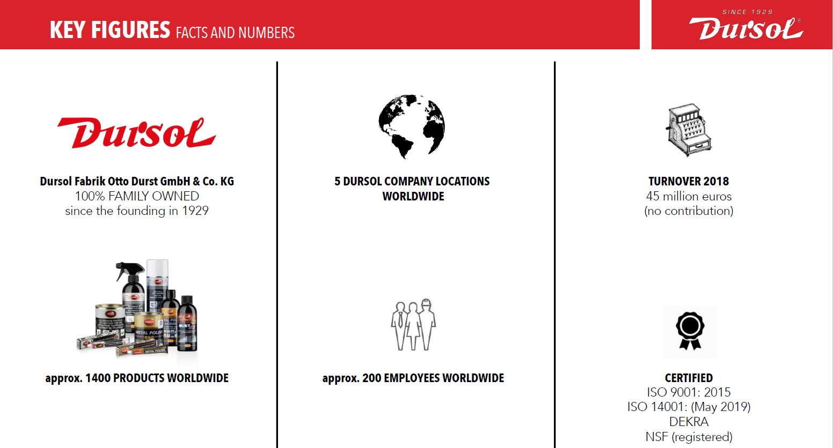

Slide 4
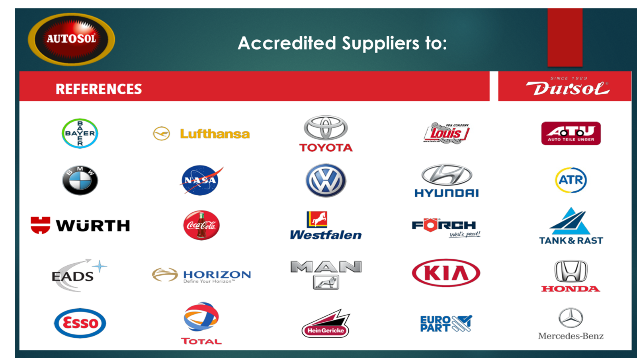

Slide 5
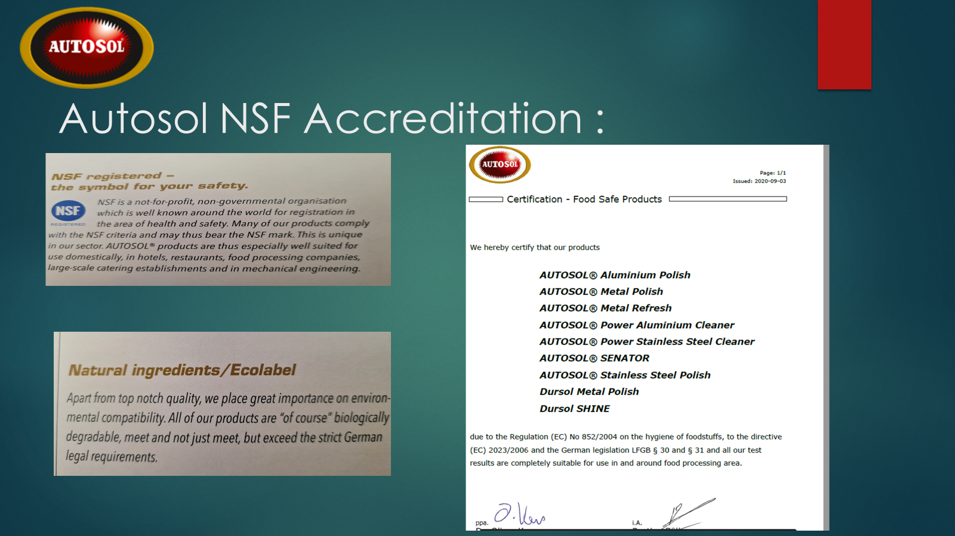

Slide 6
AUTOSOL®METAL
POLISHING, CLEANING & CARE

Slide 7
4 Factors impacting the Cleaning & Polishing Process
THE PRINCIPLES OF CLEANING$ Factors aff
CHEMISTRY:
▪not the most important influence
▪lubricant
▪protection layer
MECHANICS :
▪most important part of the polishing process
▪selective choice of the polishing particles
TEMPERATURE:
▪could be very high at very small areas
▪should not be too high, because of possible reactions with the air (oxidation)
TIME:
▪the longer the polishing process the smaller the polishing particles
▪to avoid scratches do not polish until dry

Slide 8
POLISHES
INGREDIENTSS
polishing particles (a-aluminium oxide, layered silicates, plastic flour, quartz/silica, pumice)
▪fatty acids (emulsifier, lubricant)
▪oil and wax components (lubricant, gloss enhancer, protection)

Slide 9
Autosol Product Range

Slide 10

Metal Care Range

Slide 11
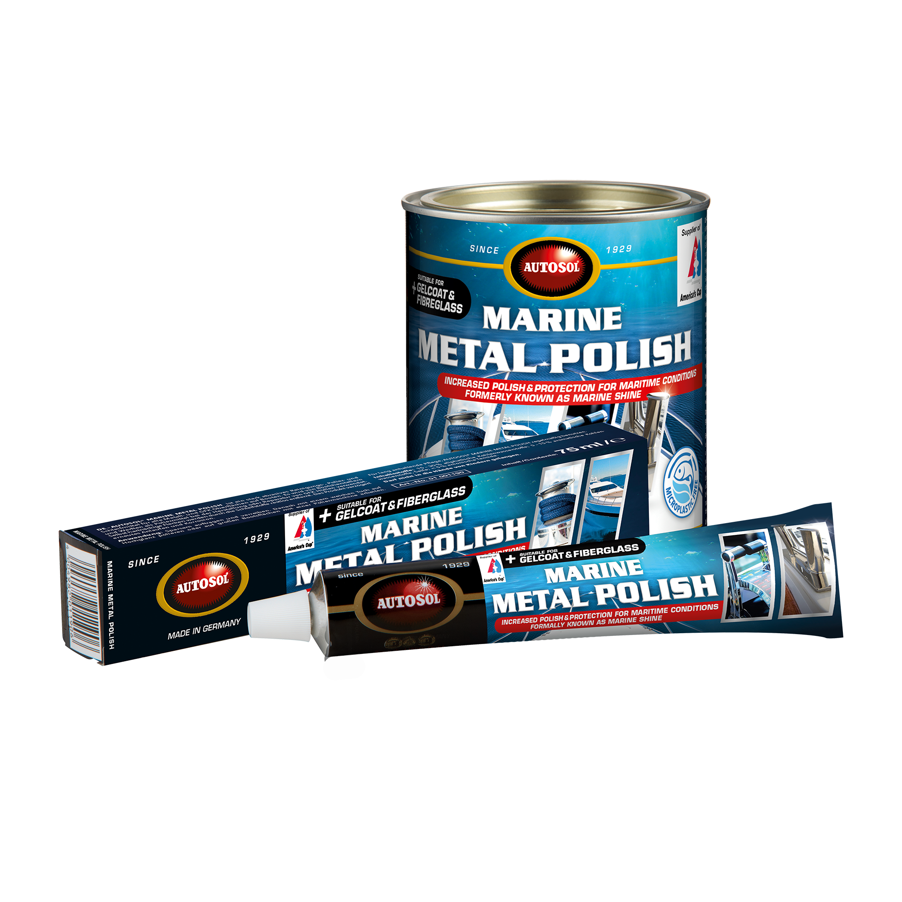
Autosol – 75ml Marine Shine
Application:
Designed to clean polish and protect all metals as well as plastic and fibreglass. Can also be used by boatbuilders as a polishing compound and may be used following the repair of GRP systems. This product removes corrosion, tarnish and discolouring, making it ideal for use on all bright metal parts.
Uses:
Polishing of all metal parts for example hand rails, chrome spot lights, cabin handles,
It may also be used as a rubbing compound for vehicle paint work, Acrylic & Synthetic materials.
Do not use on anodised Aluminium
Abrasiveness: Coarse
Article No.: 1190 Content: 75ml tube

Slide 12
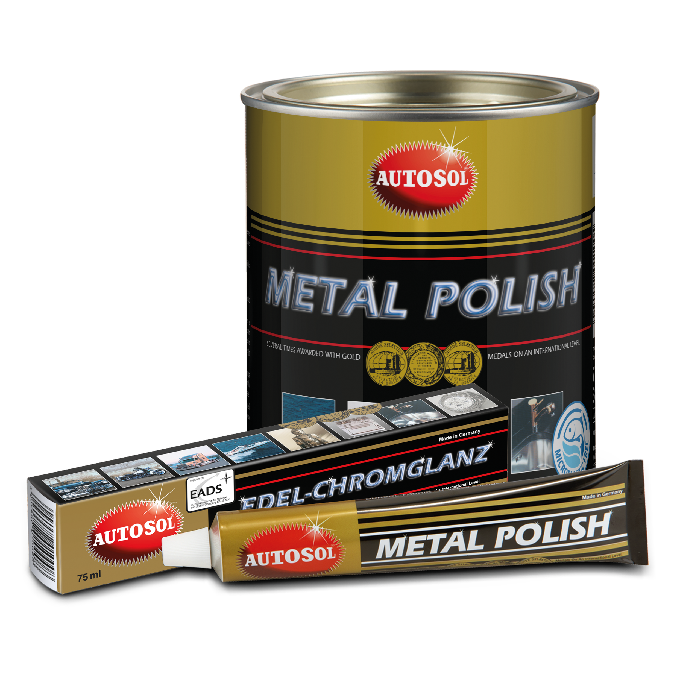
Autosol – 75ml Metal Polish
Application:
The high quality metal polish is ideal for cleaning and reconditioning most metal surfaces and is especially effective in removing rust and gives aging metal surfaces
a new brilliance.
The polish also leaves a long lasting silicone and ammonia free protective coating.
The balanced formulation of active ingredients means that the surface protection is long lasting.
Uses:
Polishing of all metal parts on cars, trucks, motorcycles, bicycles, lamps, candlesticks, musical instruments, metal furniture etc
Can be used on all metal surfaces except Brushed steel and anodised Aluminium
Abrasiveness: Medium
Article No.: 1000 Content: 75ml tube

Slide 13
Autosol – Shine Polish
Application:
This domestic metal cleaning product has the ability to not only clean metal surfaces but to
also protect them from tarnishing. SHINE Metal Polish is ideal for cleaning, polishing and
protecting bright metal surfaces around the home and commercial areas. Great for polishing
aluminium, stainless steel, brass, copper and most metals.
Uses:
Home use on all metal surfaces except Brushed steel and anodised Aluminium
Abrasiveness: Medium
Article No.: 11189 Content: 75ml tube

Slide 14
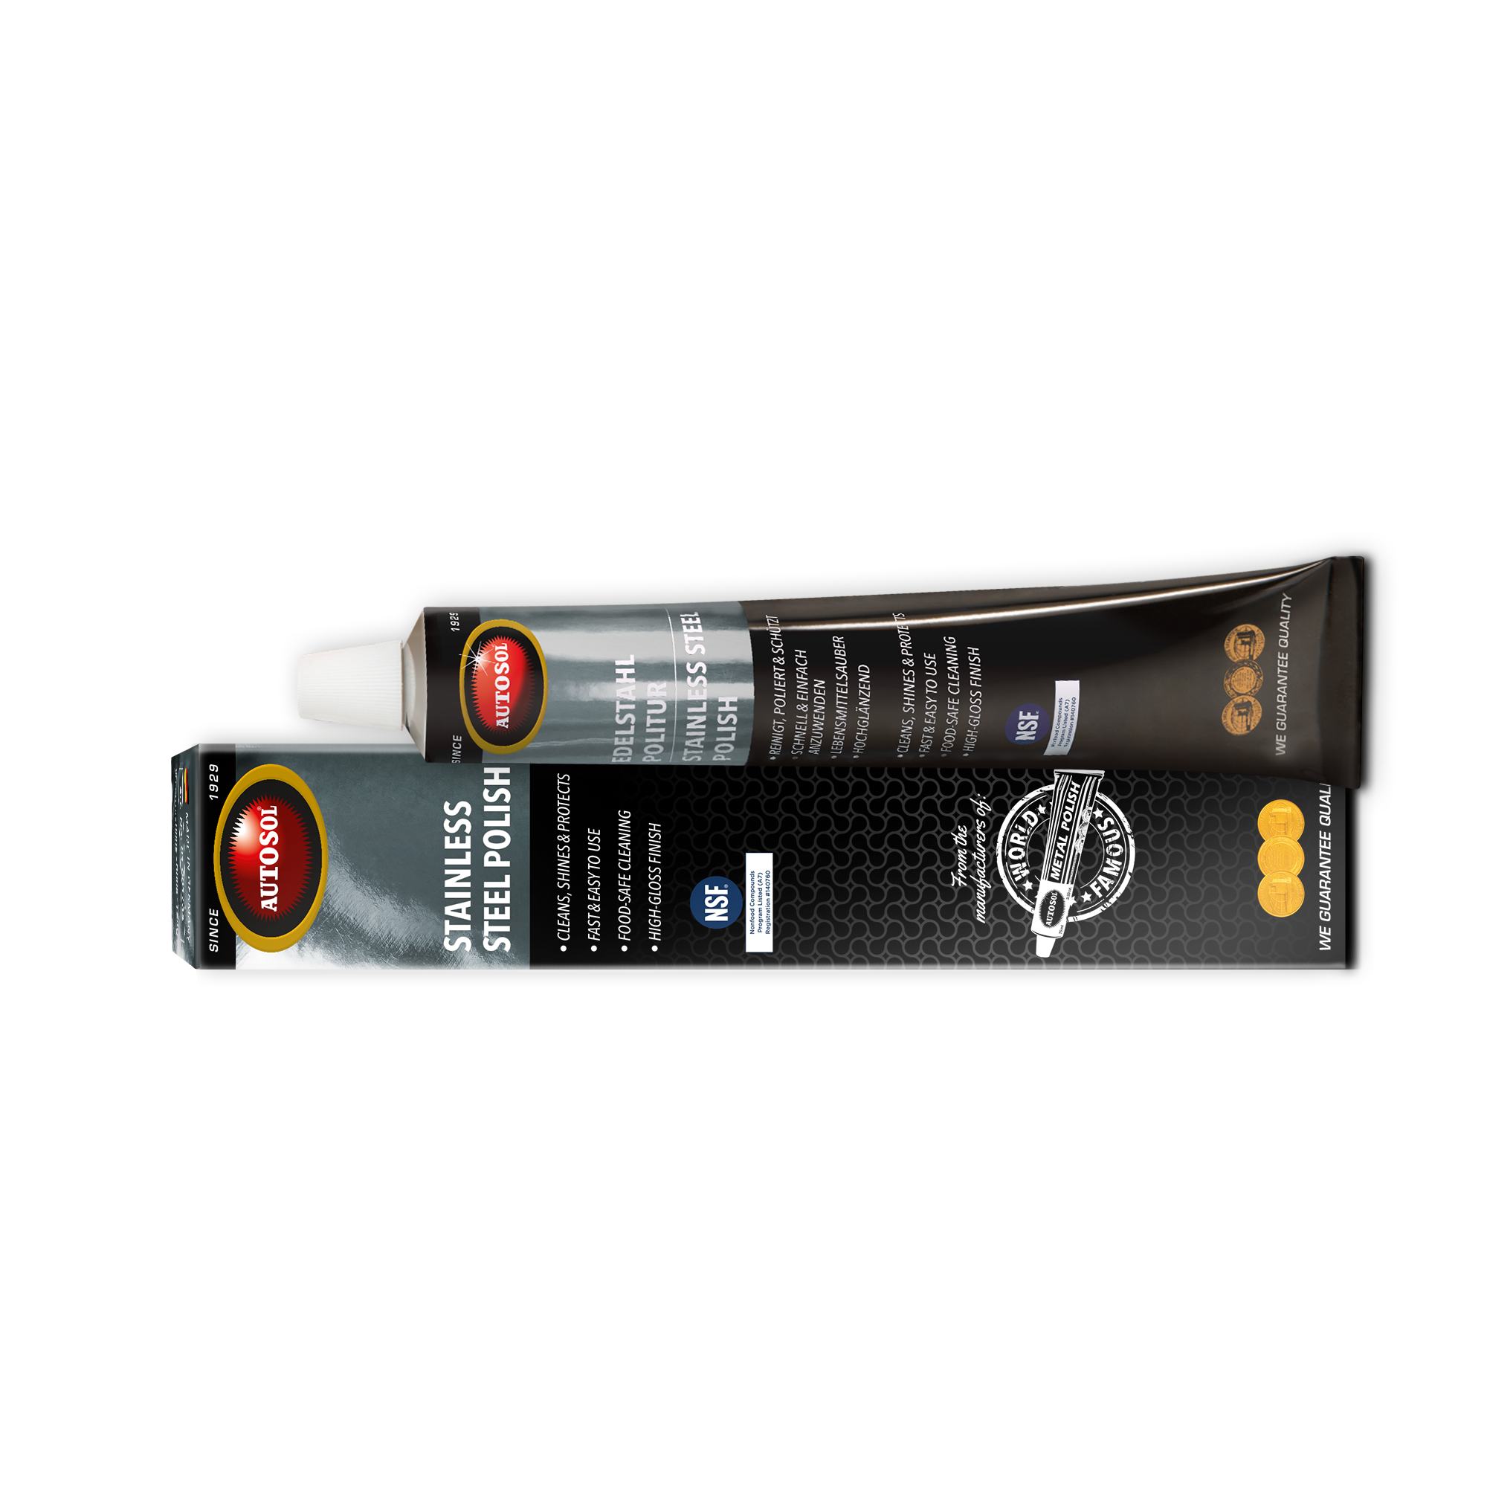
Autosol – Stainless Steel Polish
Application
Apply a thin layer of AUTOSOL® Stainless Steel Polish and buff up with a soft cloth in a circular
motion until a black residue forms. Then polish with a clean cloth to produce a brilliant shine.
We recommend AUTOSOL® Stainless Steel Power Cleaner for removing polish residue. Treat
with AUTOSOL® Metal Guardfor a longer lasting shine.
Abrasiveness: Fine

Slide 15
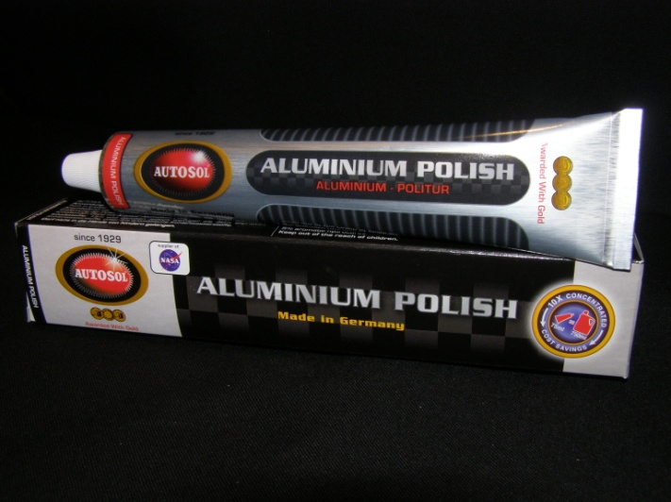
Autosol – 75ml Aluminium Polish
Product Information:
The product has been scientifically formulated to meet the needs of Aluminium and other softer metals and after the application of the polish a protective layer is left behind. The formula contains no ammonia
Uses:
Aluminium Mag wheels, Aluminium engine parts
Abrasiveness: mild
Article No.: 1824 Content: 75ml tube

Slide 16
Autosol – Super Gloss
Product Information:
Produces a spectacular shiny finish.
Recommend to polish initially with
Autosol Metal Polish followed by
Autosol Metal Polish Super Gloss
to achieve the ultimate reflection
Applicable on various materials:
metals (aluminum, copper, brass,
stainless steel, chrome ...), plastic,
paint and fiberglass.
For that extra shiny Finish!!!
Abrasiveness: Very Low Abrasive
Article No.: 1125 Content: 75ml tube
250ml bottle

Slide 17
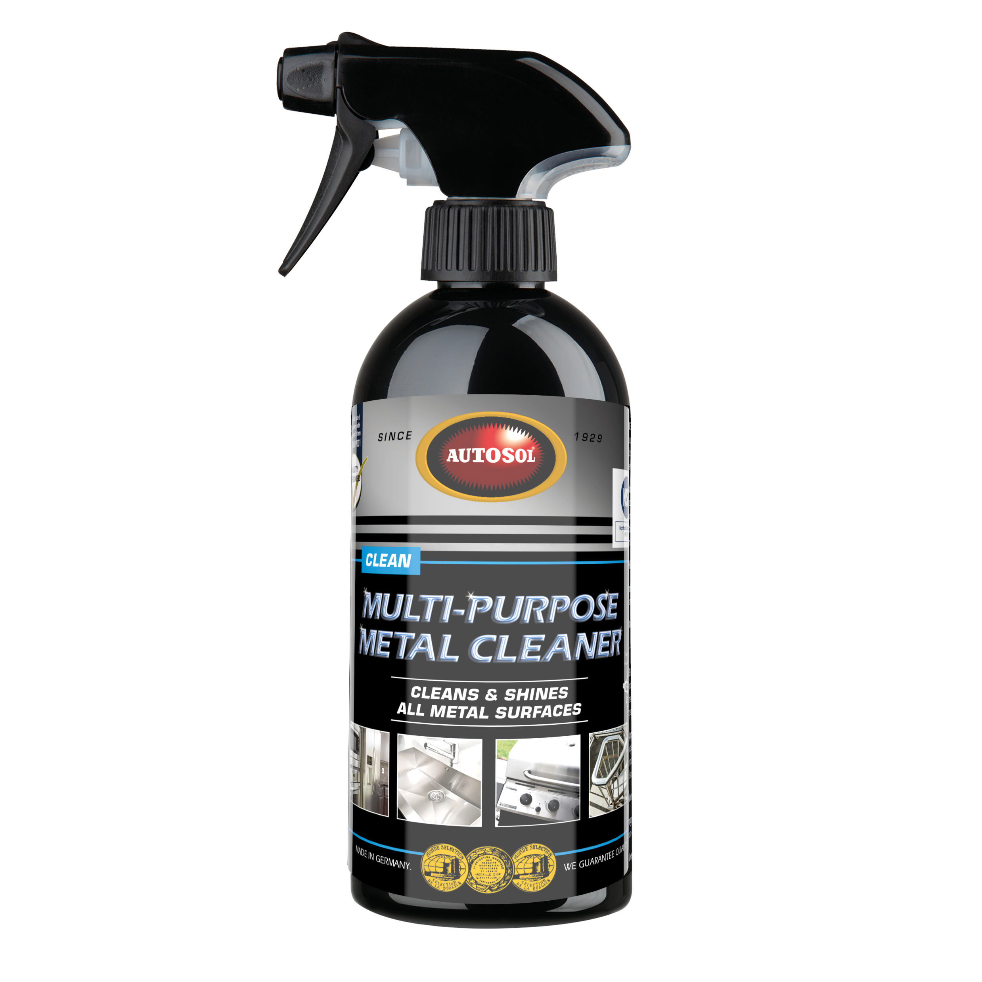
Autosol – 750ml Stainless Power Cleaner
Product Information:
Made for stainless steel, chrome, brass, anodised and enamelled metal
surfaces, aluminium alloys, and non-ferrous metals, in the home, kitchen
or work place involving food
Food Safe
Uses:.
It is a powerful multipurpose cleaner to remove, dirt, grease and food stain residues. Neutral in colour and odour. Tested
for safe use in food preparation areas.
Abrasiveness: Low Abrasive
Article No.: 1900 Content: 750ml tube

Slide 18
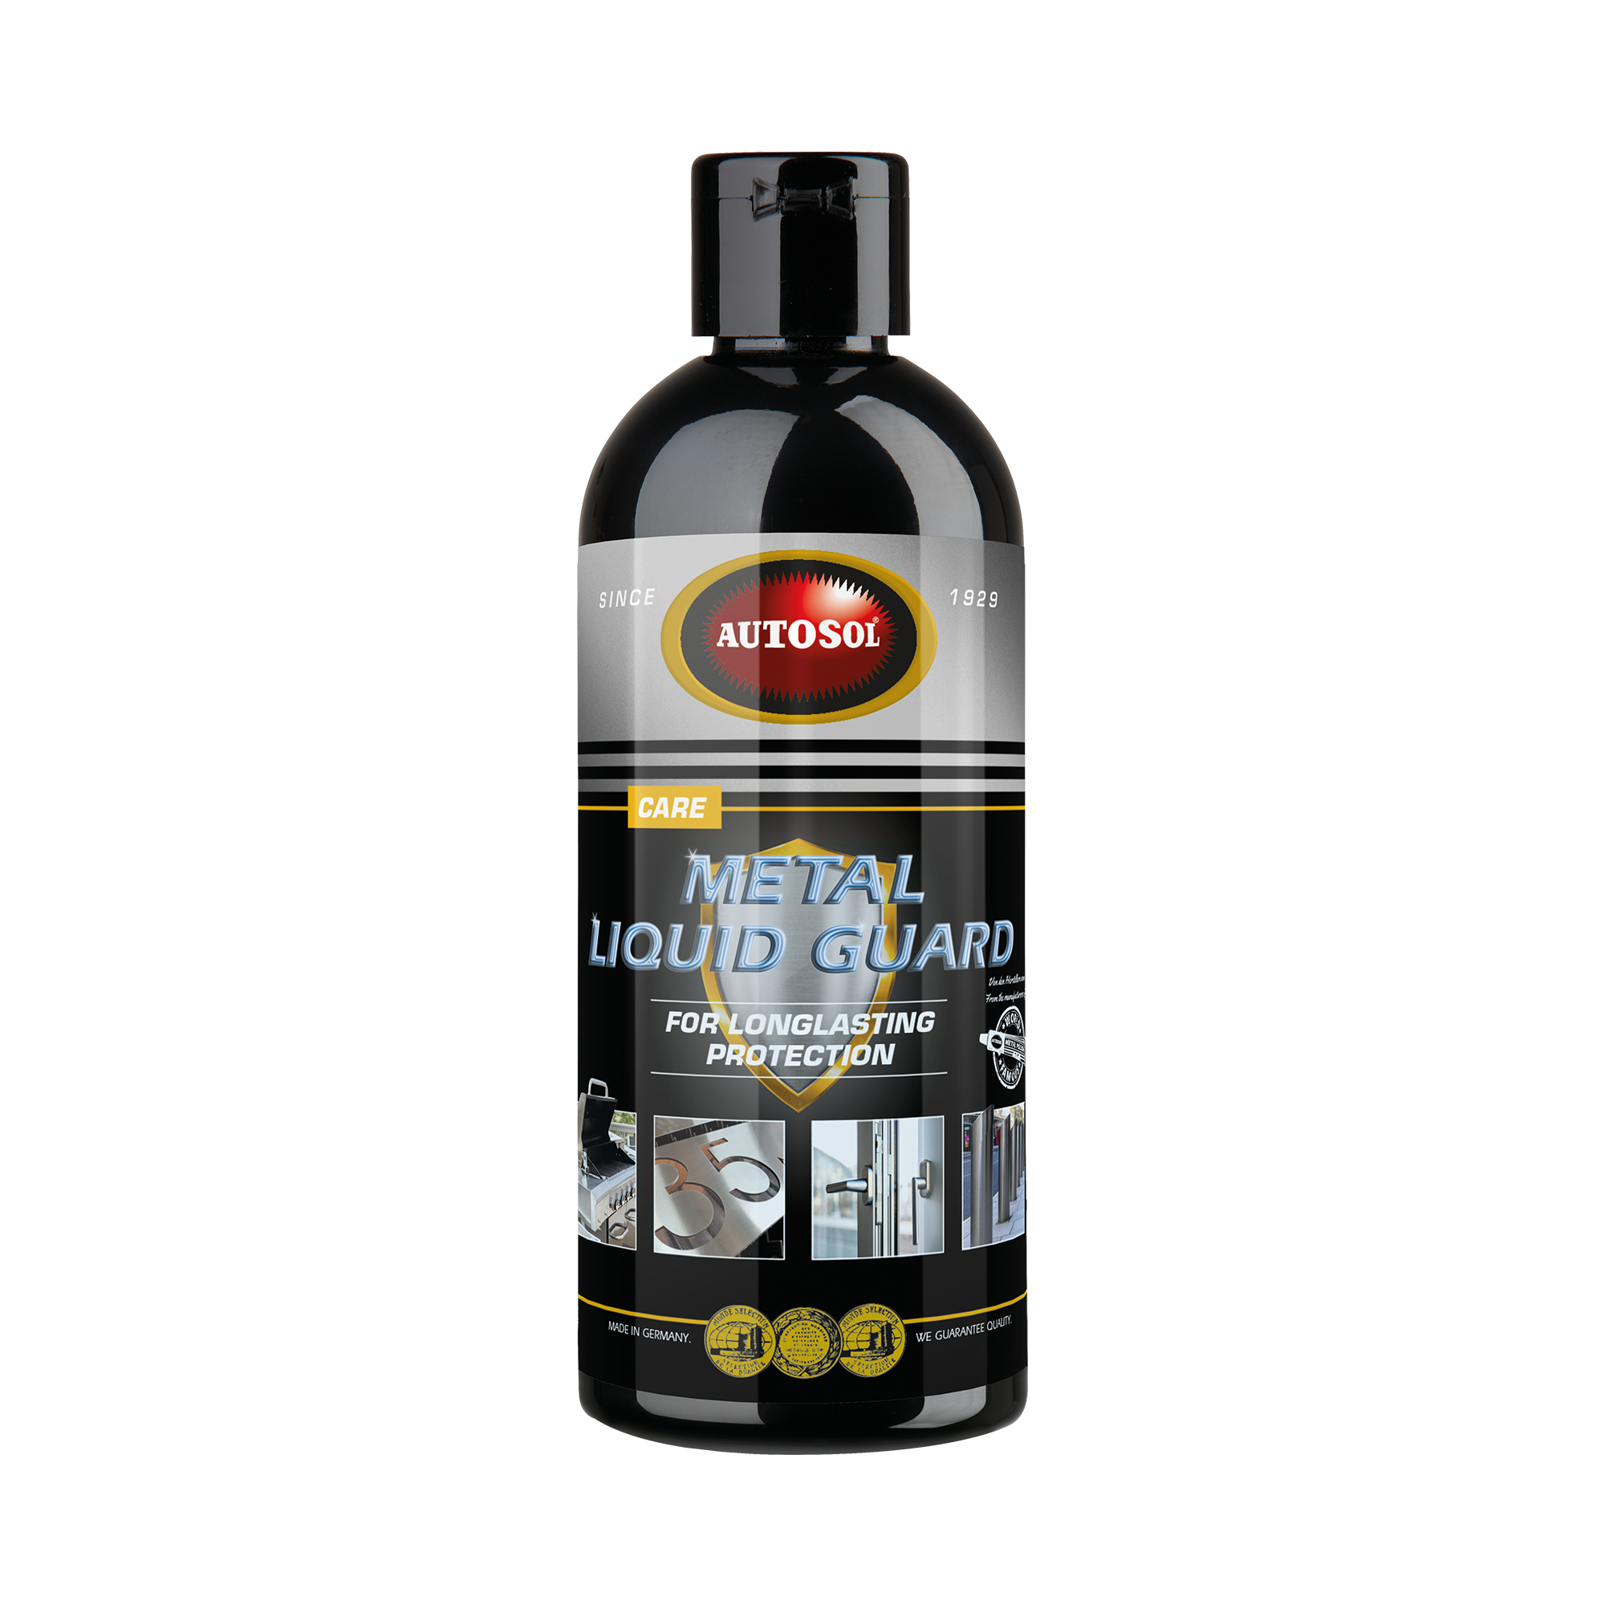
Autosol – Metal Liquid Guard
Product Information:
AUTOSOL® METAL LIQUID GUARD provides long-lasting protection for all metal surfaces made of stainless steel, copper, brass, chrome, aluminium, etc. The product forms a water-repellent protective layer and leaves the surface clean and shiny. Prevents tarnishing of non-ferrous metals and minimises the adhesion of dirt, dust, water stains and fingerprints.
Uses:.
Apply to all metal forlong-lasting protection except anodised Aluminium
Abrasiveness: Non Abrasive
Article No.: 1140 Content: 250ml bottle

Slide 19
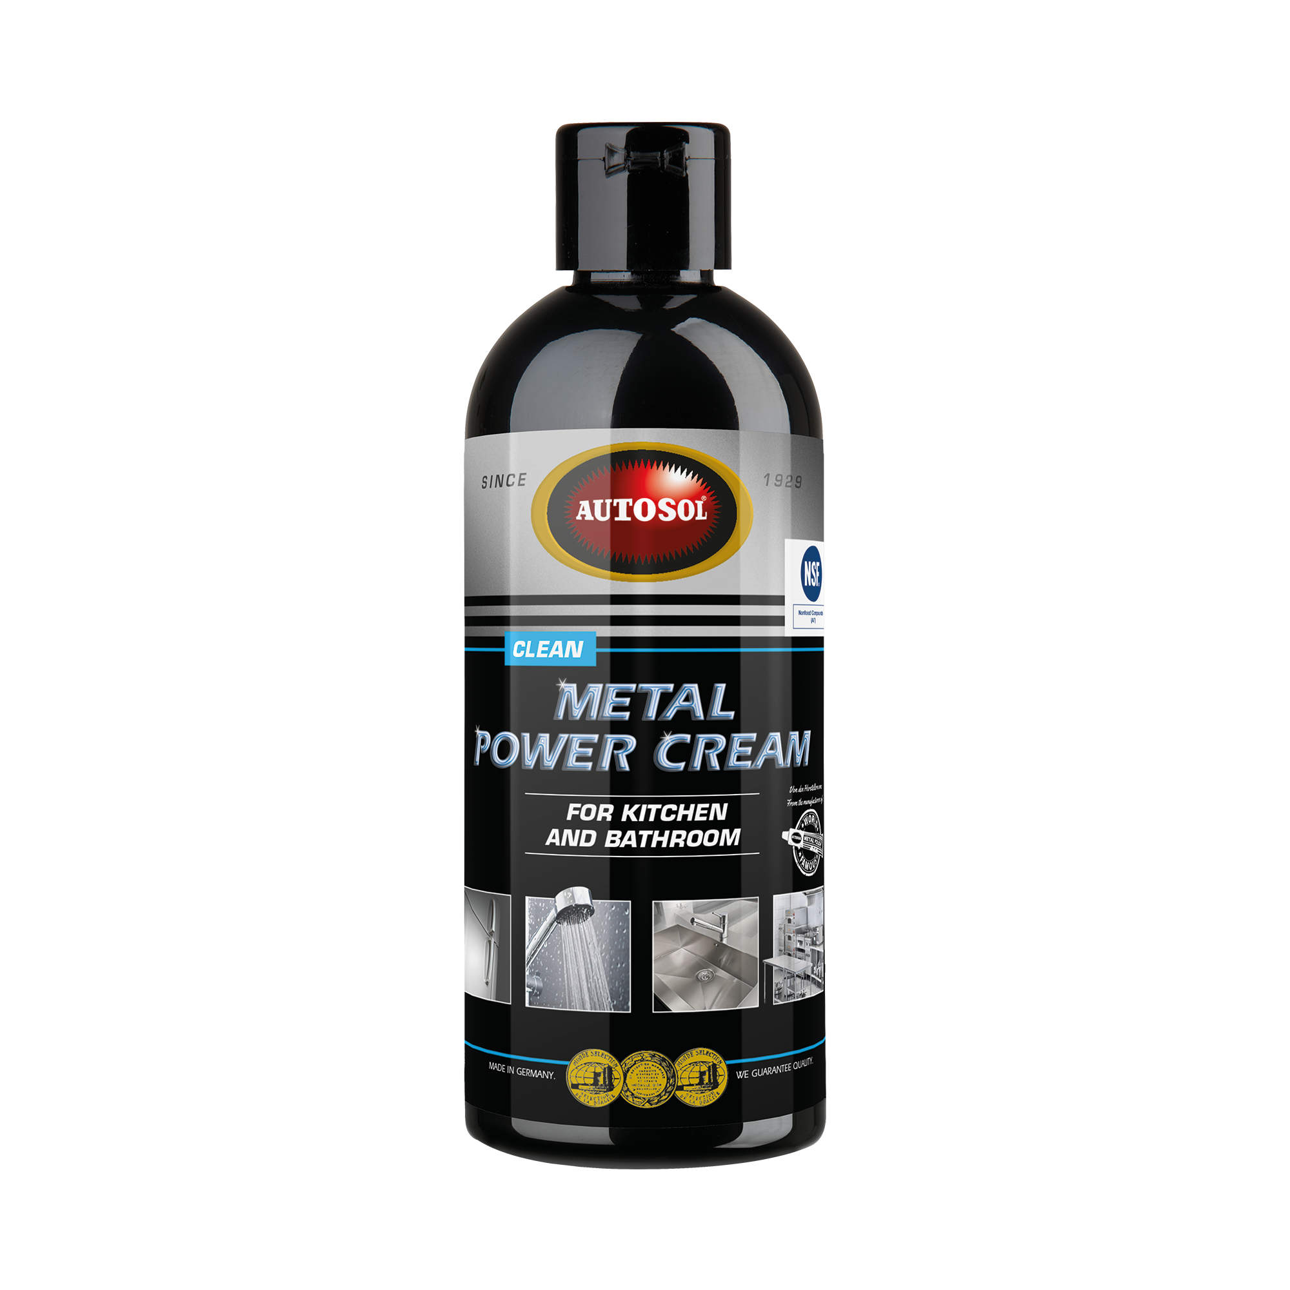
Autosol – Metal Power Cream
Product Information:
AUTOSOL® METAL POWER CREAM Ideally suited for surfaces made of stainless steel, chrome, brass, copper, aluminium as well as glass and glass ceramics. The combination of mild acid and high-quality alumina effectively and gently removes stubborn dirt, limescale, water scale, metal oxidation and flash rust.
Application
Apply sparingly to the surface to be cleaned. Polish evenly and in circles with a damp sponge or cloth. Finally, rinse thoroughly with potable water.
Note
Avoid direct contact with food. Not suitable for use on painted, lacquered, anodised or powder coated surfaces.
Uses: Ceramic & Marble tops, taps, sinks, steel pots,
shower heads, shower doors, bathroom basin, ceramic cups
Abrasiveness: Fine
Article No.: 1720 Content: 75ml tube

Slide 20
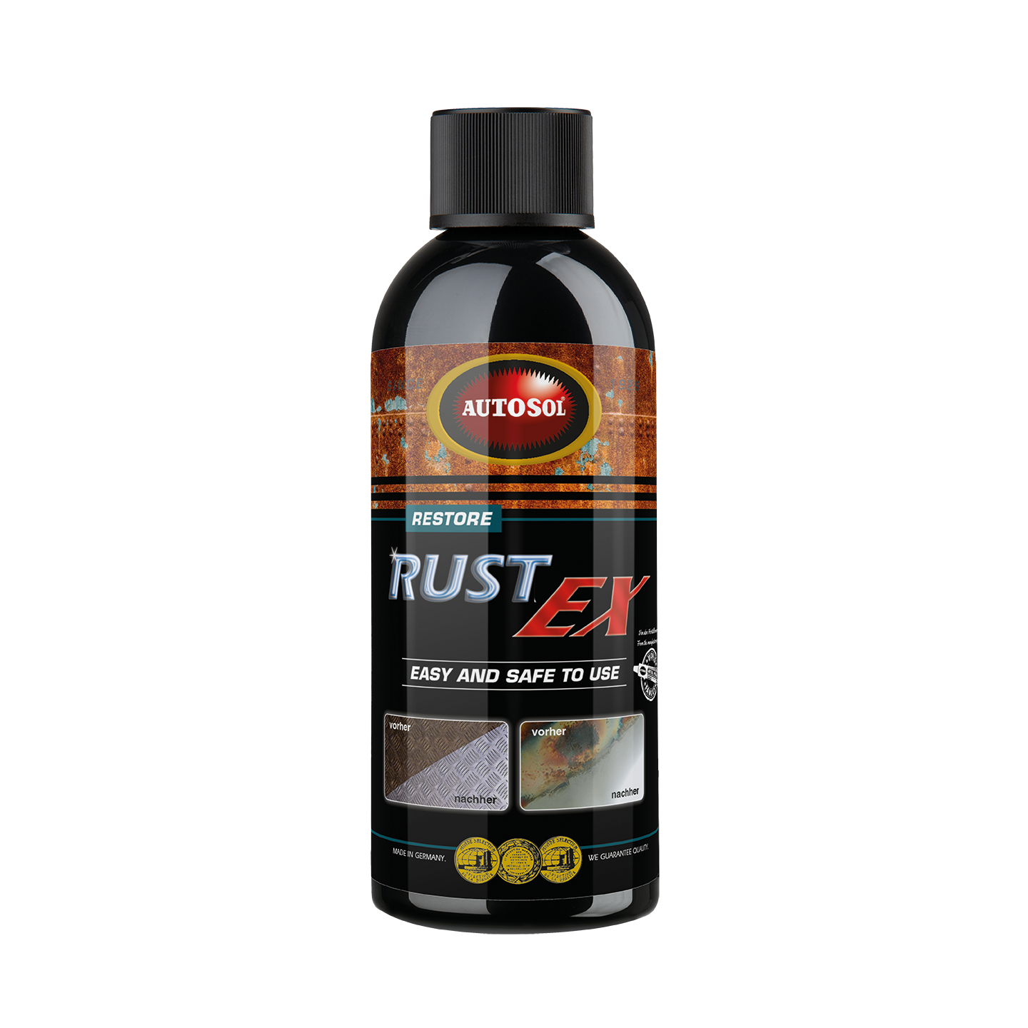
Autosol – Rust-Ex
Product Information:
The combination of active chemical ingredients and manual polishing abrasives lead to an unique formulation designed to remove heavy corrosion and staining from most metals, restoring the shine and extending the life of your metal surface. Corrosion inhibitors prevent attack on non-corroded parts. Economical and easy to use. Ideal for treating large areas of iron, bronze, copper, steel etc.
RustEx does not contain poisonous chemicals
Application
Shake well. Rub into corroded area with clean cloth or sponge. Depending
on the grade of corrosion allow product to act for an appropriate time (1 – 5 minutes). If
necessary use hard sponge or brush to assist the cleaning process. Do not allow product
to dry. Once surface is stain-free, wash off with water and dry.
Article No.: Auto-D34250 Content: 250ml Bottle

Slide 21
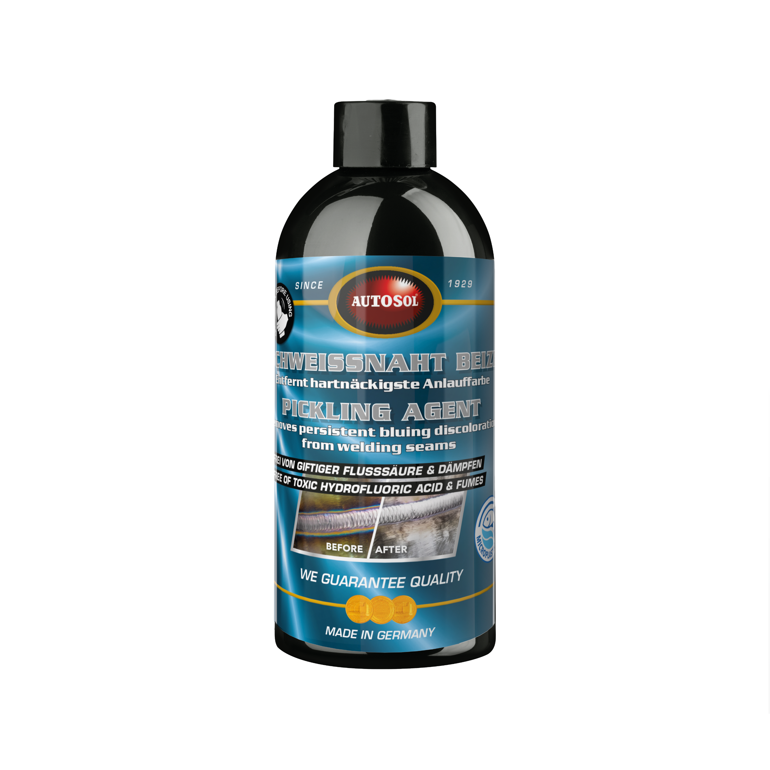
Autosol – Pickling Agent
Product information
This formula combines active chemical ingredients and manual polishing abrasives to remove even the most persistent burns and bluing discoloration from stainless steel welding seams. Based on the combination of modern raw materials, it is very effective.
This product does not contain toxic hydrofluoric acid!!
Application
Shake well before use. Apply a small amount of AUTOSOL® PICKLING AGENT onto a cloth or sponge and spread over the effected areas. Depending on the type of stainless steel and grade of discoloration, allow product to take effect up to 30 min. (do not let product dry). Afterwards polish the surface with a cloth. Reapply as needed or use a rough sponge. Finally rinse surface thoroughly with water.
Article No.: 34001 Content: 500ml bottle

Slide 22
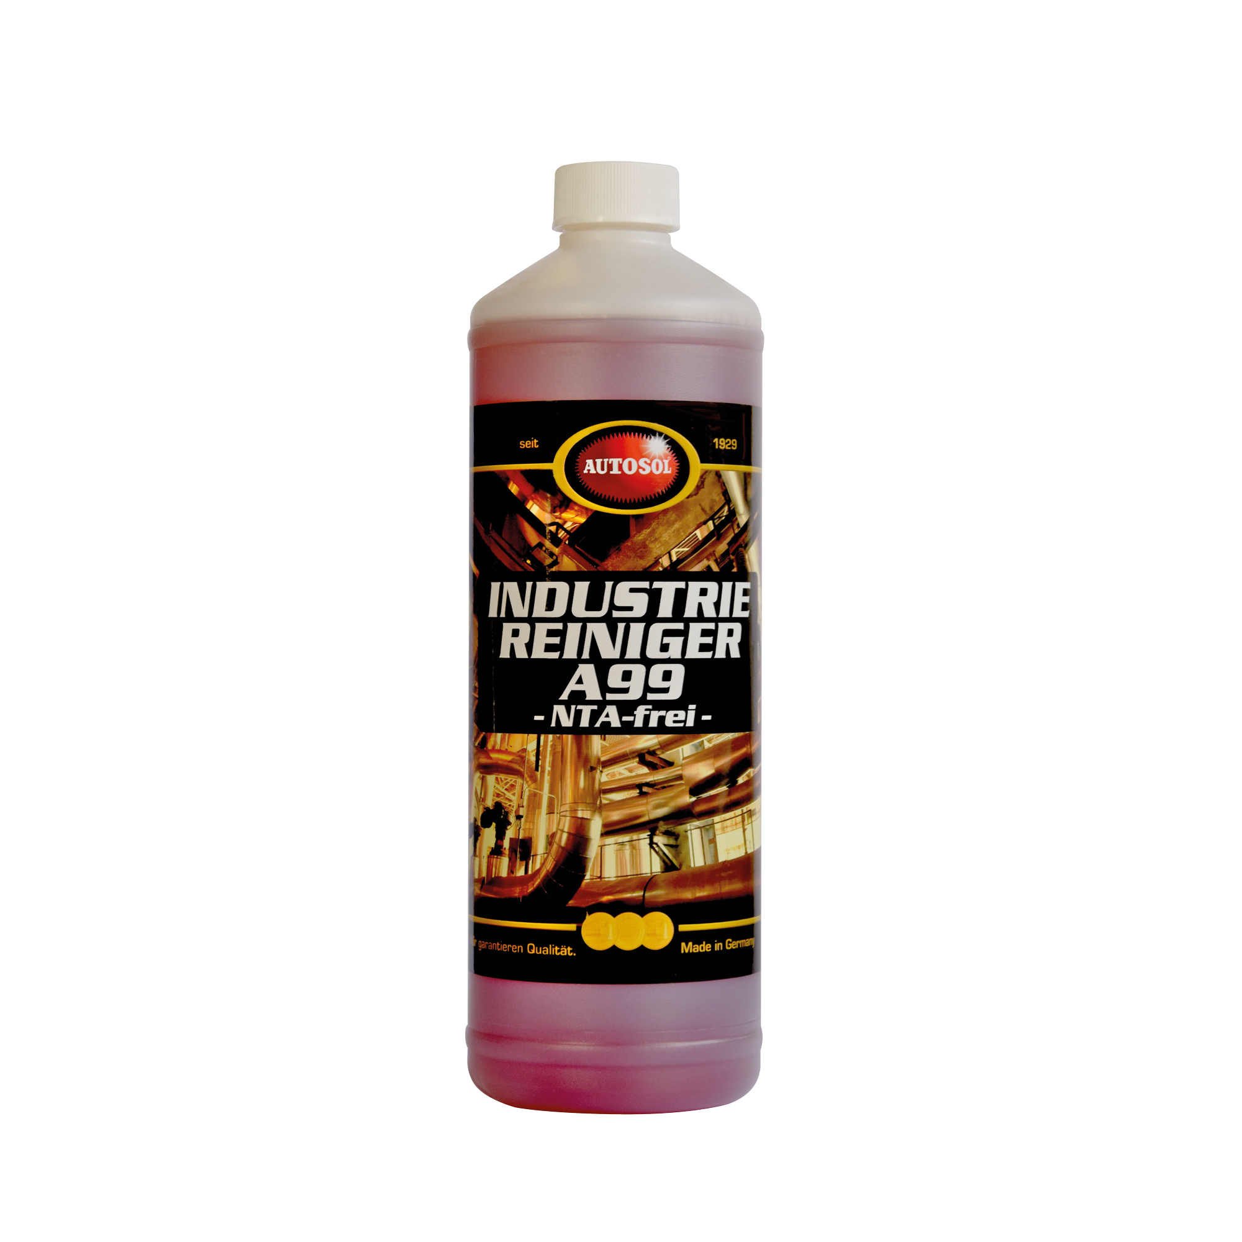
Autosol – A99
Product Information:
Extremely strong, alkaline cleaner concentrate. Designed for demanding requirements of the
professional user. Triggers all kinds of dirt, grease, oil, and insect remains in the shortest
possible time. Suitable for all alkali-resistant surfaces. (Possibly to regulate pH) Suitable for allwater hardness and water recycle systems. NTA-Free. A sustainable cleaning product in the car care and industrial markets that breaks down safely in the water without harming aquatic life or enviroment.
Uses:
Degreaser cleaning of vehicles, trucks and machinery, oil spills
Article No.: 14102 Content: 1l, 5l, 25l

Slide 23
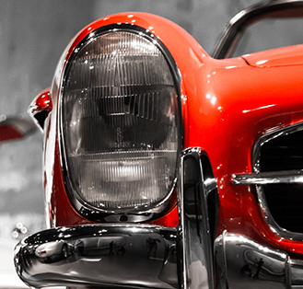
Care Care Range

Slide 24
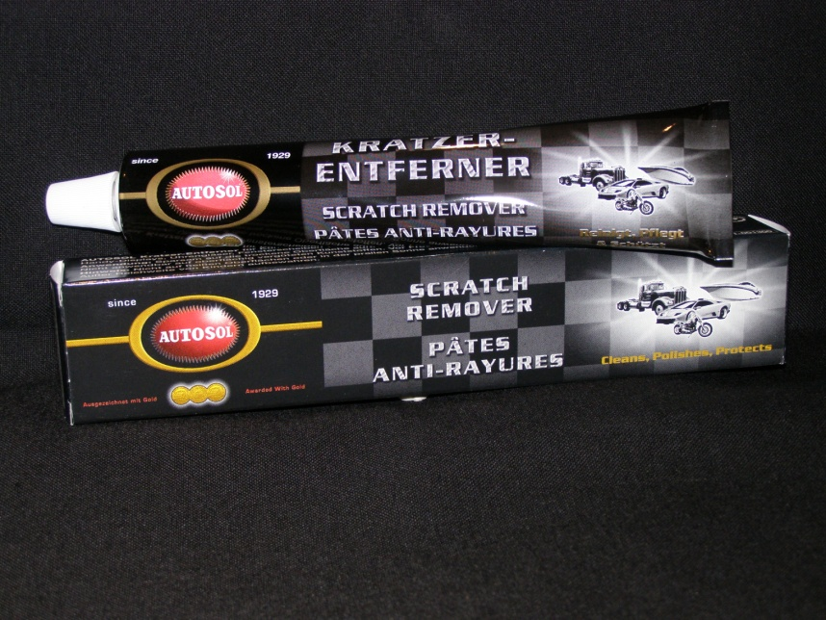
Autosol – 75ml Scratch Remover
Application:
The product is ideal for removing minor scratches on lacquer coatings, plasticized materials and glass.
Uses:
Helmet visors, mobile phone screens, watch faces, surface scratches on lacquer paint, plastic windows
Abrasiveness: Medium/Coarse
Article No.: 1300 Content: 75ml tube

Slide 25
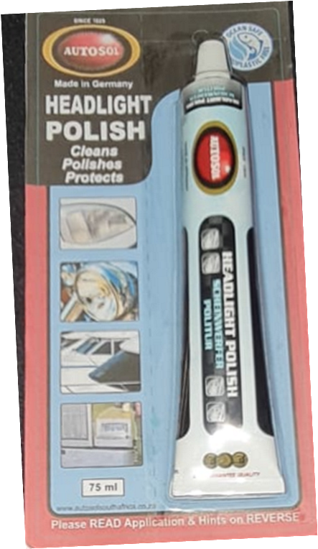
Autosol – 75ml Headlight Polish
Product Information:
Carefully cleans head and tail lights. Removes discolouring and light scratches and soiling leaving a sparkling clean finish
Uses:
Headlights, Tail lights, Visors, Polycarbonate Windsctreens
Abrasiveness: Medium Abrasive
Article No.: 1385 Content: 75ml tube

Slide 26
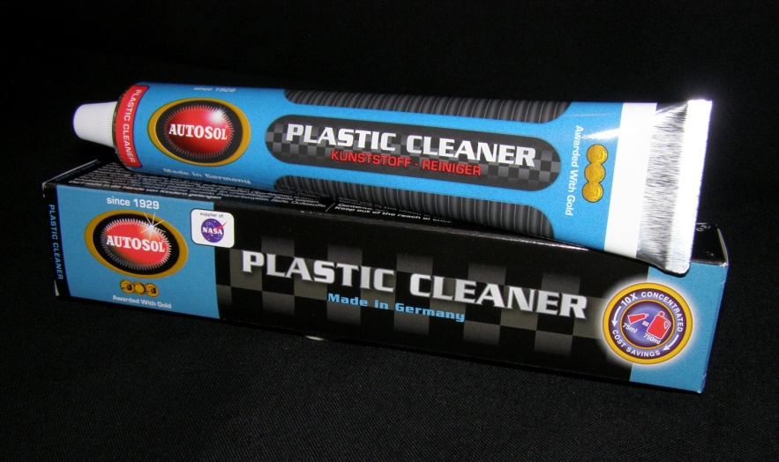
Autosol – 75ml Plastic Cleaner
Product Information:
Cleans and protects all plastic surfaces. The product has a colour-restoring
and anti-static effect. No layer build-up after repeated use.
Uses:
Dash boards (matt or shiny), plastic seats, plastic interior, Computer equipment
Abrasiveness: Non Abrasive
Article No.: 1020 Content: 75ml tube

Slide 27
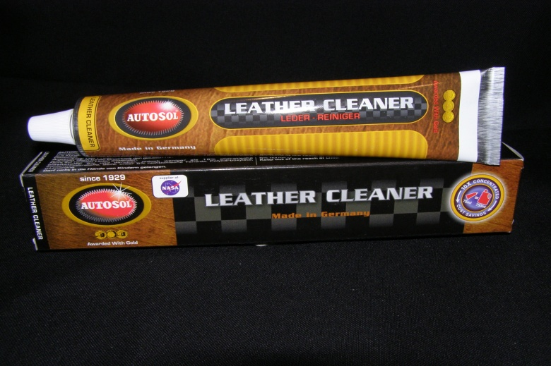
Autosol – 75ml Leather Cleaner
Product Information:
Cleans and revives genuine and vinyl leather as well as matt plastic parts. The product imparts new depth of colour and elasticity
Uses:
Leather seats, Leather Jackets, Leather boots, saddles
Abrasiveness: Non Abrasive
Article No.: 1040 Content: 75ml tube

Slide 28
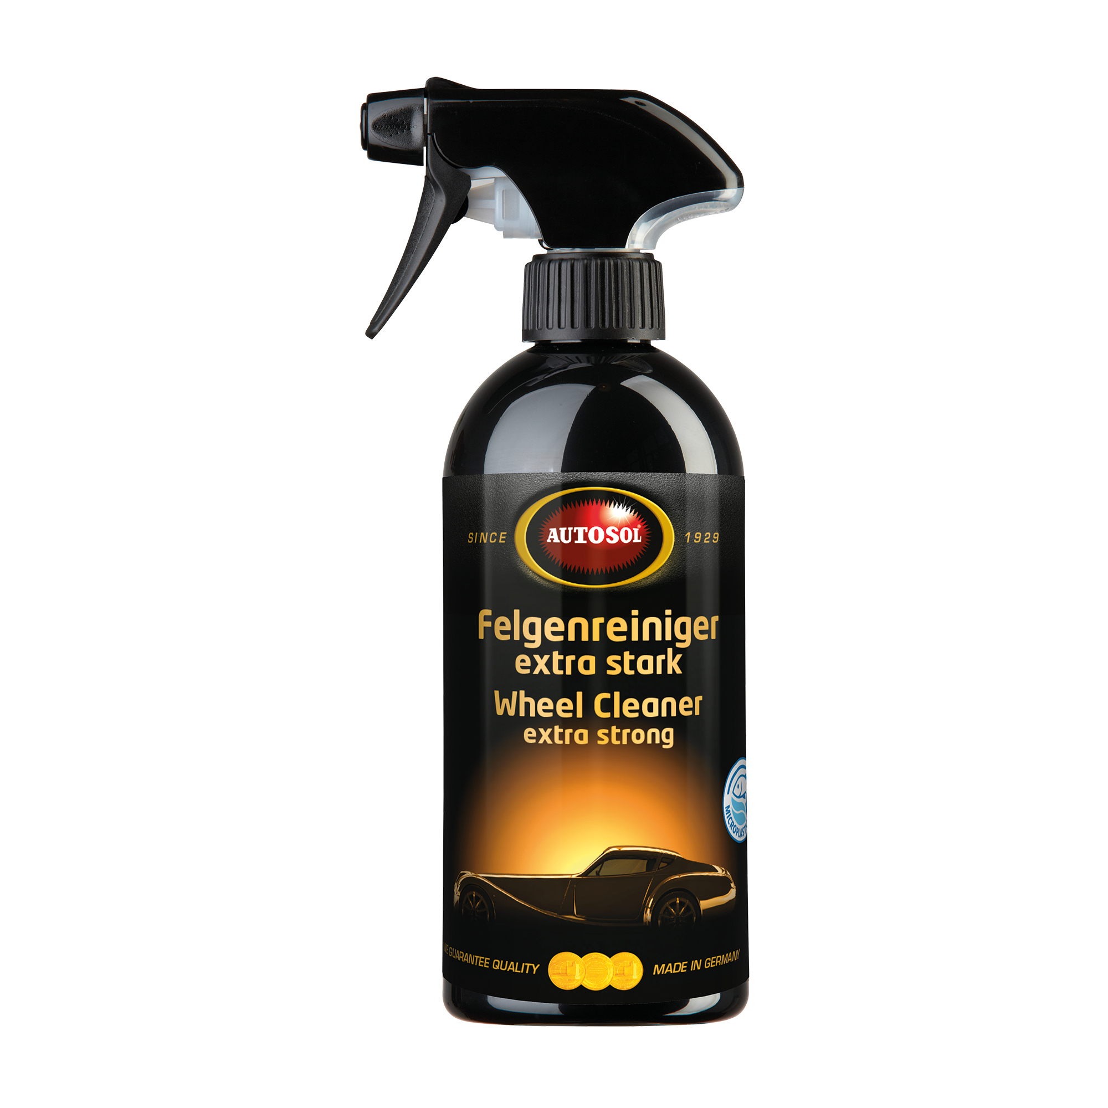
Autosol – Wheel Cleaner
Product Information:
AUTOSOL® WHEEL CLEANER HIGH PERFORMANCE easily removes even stubborn dirt such as burned-in brake dust, residues from rubber and tar plus other street dirt. Safe to use on all
steel and light metal alloy wheel rims and hubcaps. It also creates a nonstick effect making future cleaning easier. It is acid-free and does not attack either the surface of the wheel rim nor the wheel bolts. This product is PH Neutral
Application:
Spray from approximately 15 – 20 cm from the surface; allow 3 – 5 minutes for cleaner to activate. As the cleaner activates and lifts the dirt, the colour will change from yellow-green to dark red. The residue can be removed with a high pressure washer or hose. To assist with the removal of stubborn dirt use a wheel brush.
Article No.: Auto-12650 Content: 500ml Spray Bottle

Slide 29
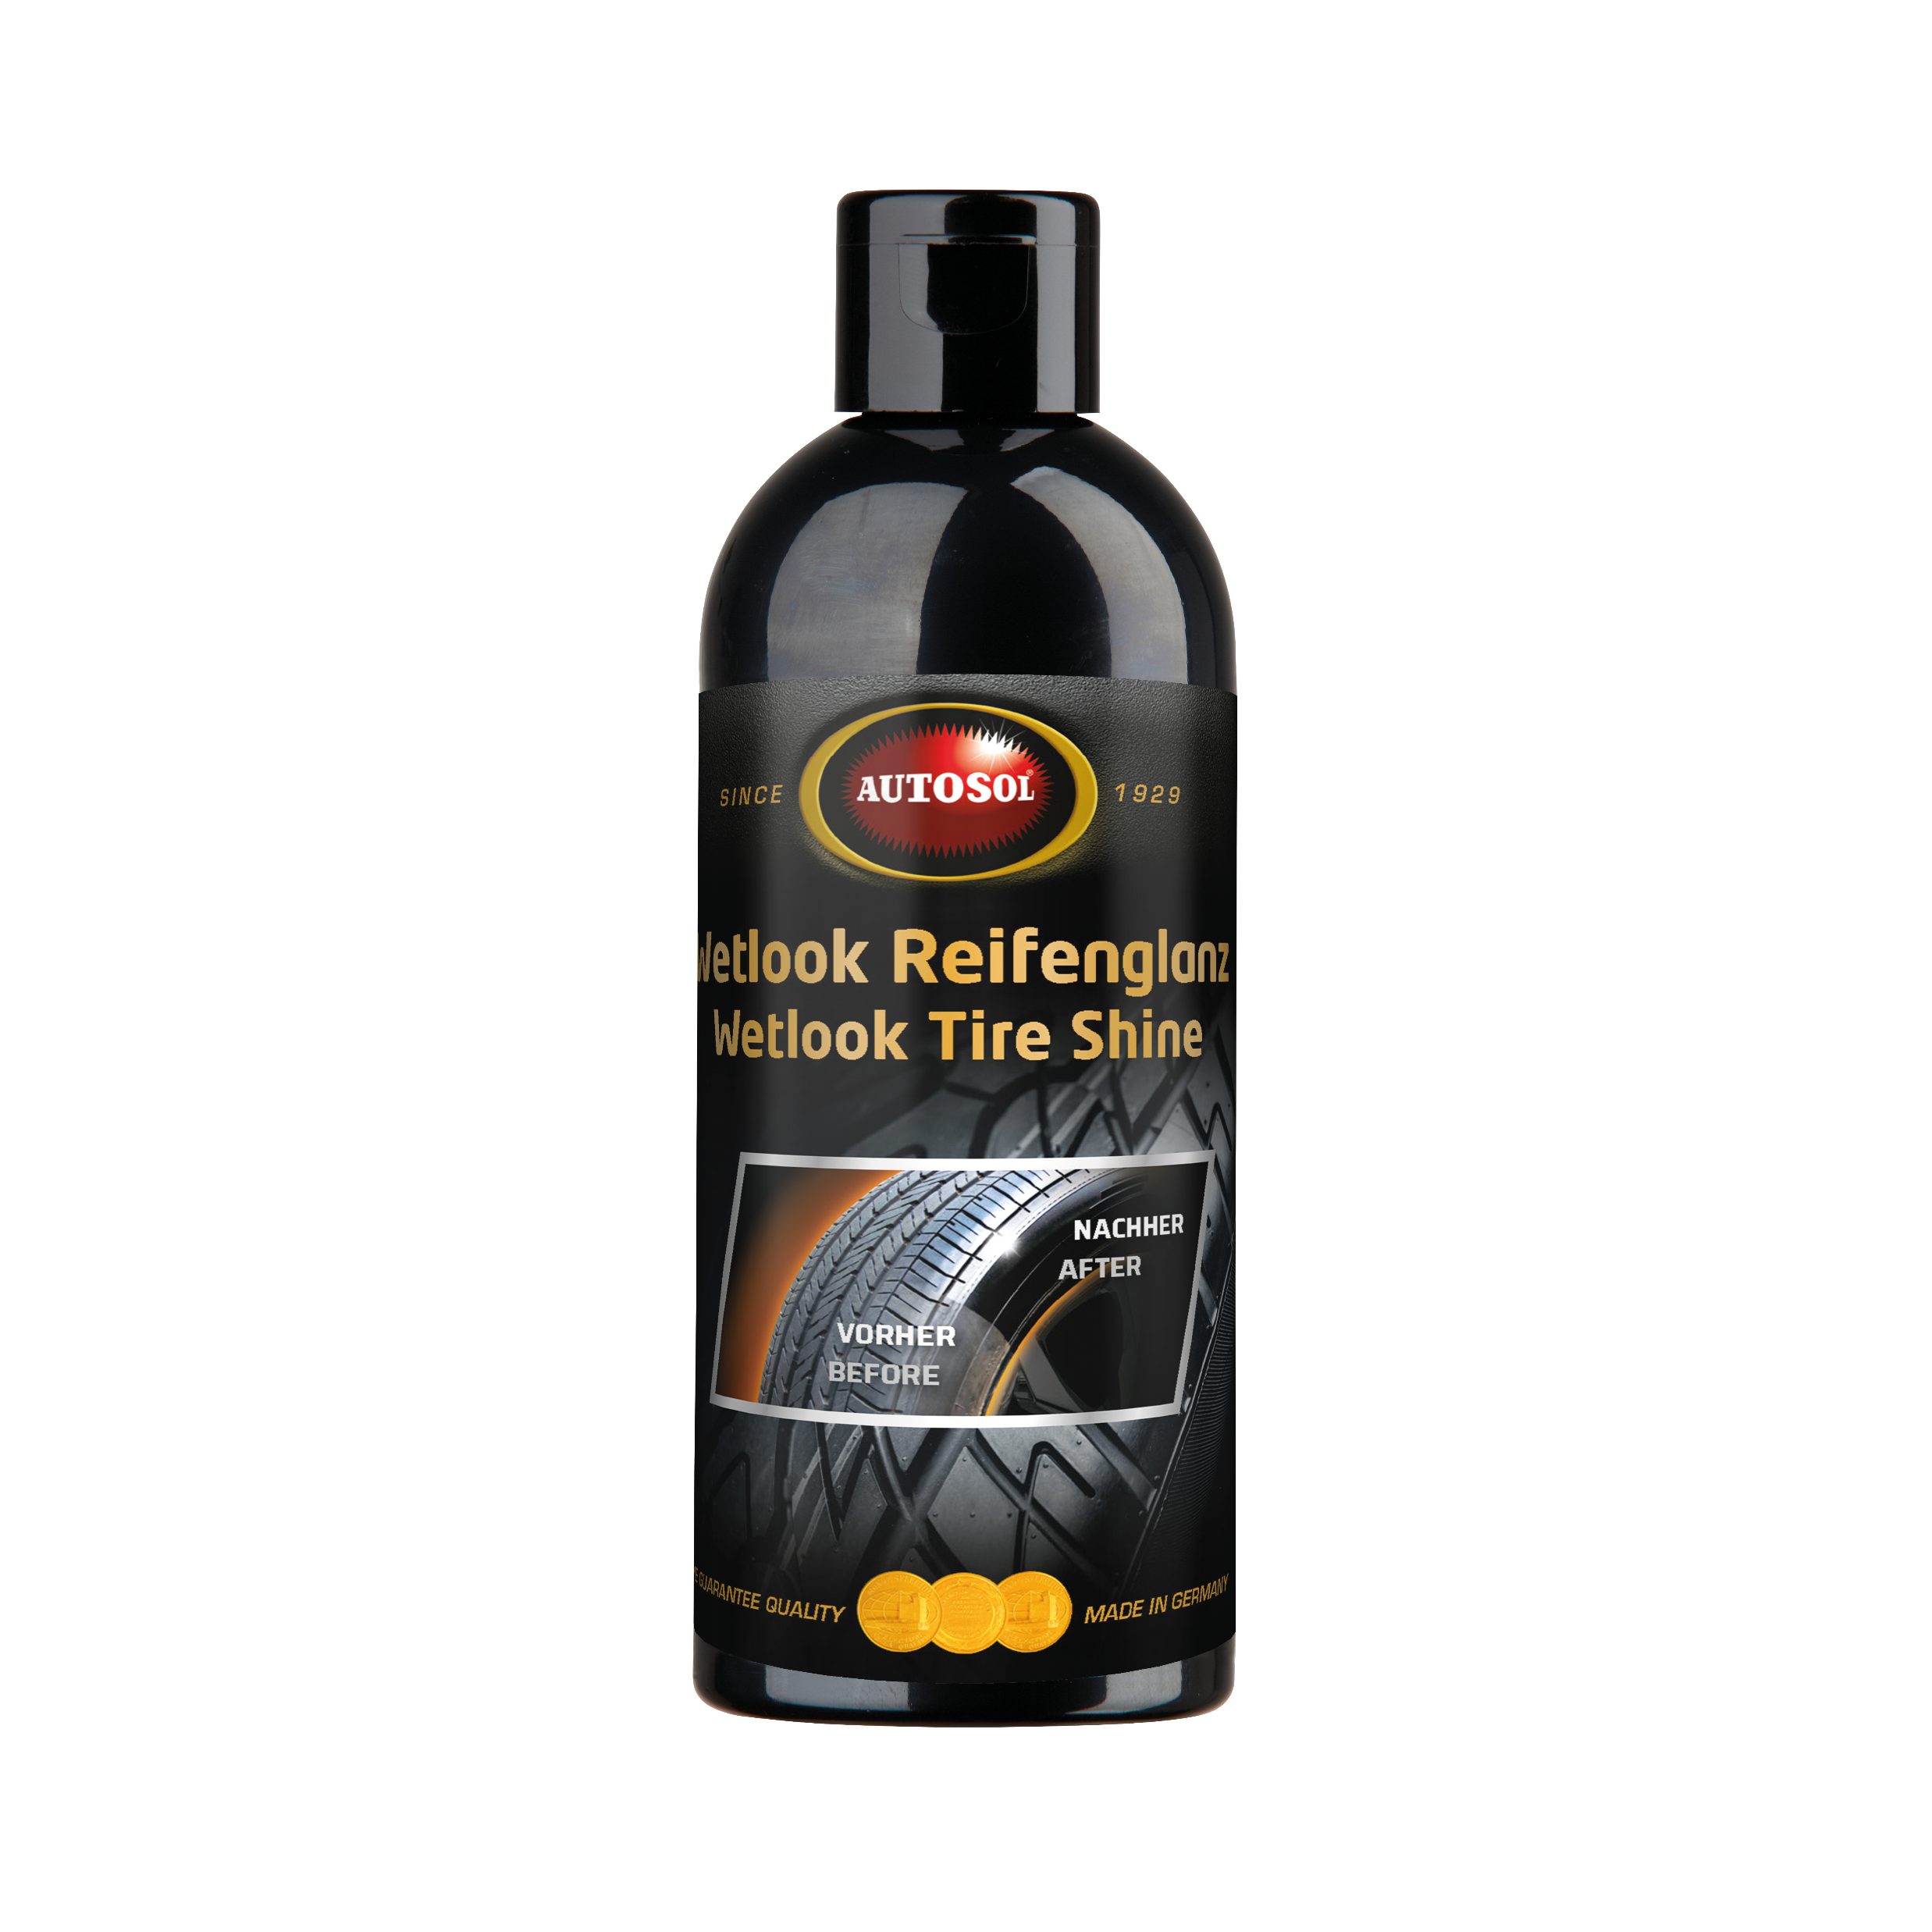
Autosol – Tyre Shine Wet look
Product Information
Protects and cares for all types of tyres against dehydration and embrittlement. i.e it moisturises the tyre by means of repeated application. It gives a long lasting deep shine for weeks and the tyres regain their fresh and clean new look.
Application
Shake bottle well before use. Apply AUTOSOL® Wetlook Tire Shine with the sponge onto cleaned and dry tire walls. Do not apply on the tire running surface. According to your needs,
you can apply a second layer of tire shine to maximize the
wetlook effect.
Article No.: Auto- 1640 Content: 250ml Bottle

Slide 30
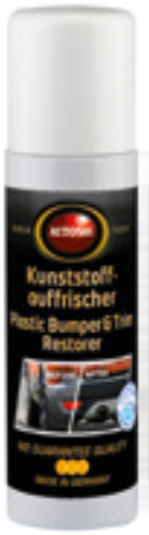
Autosol – Bumper &Trim Restorer
Product Information:
The AUTOSOL® Plastic Bumper & Trim Restorer revives and seals weathered and faded plastic parts on cars with a long-lasting effect. The Easy-to-use formulation is perfect suitable for professional detailersas well as for end-users. It protects painted or unpainted bumpers, trim strips, exterior mirror housings and other plastic add-on parts with a strong UV protective film. It dries clean with zero residues and leaves a non-glossy finish.The product offers outstanding durability and long-lasting protection. It gives back faded parts theiroriginal dark appearance and protects them from fading again.
If required, the Autosol® Plastic Bumper & Trim Restorer can be applied several times.
Application
Before use, clean and dry the surfaces to be treated. Ideally, it should be applied after a car wash.
Shake the bottle well before use. If necessary, apply several times and polish with a dry cloth.
Note
Not suitable for use on headlights or polycarbonate plastics!
Article No: Auto-8251 Cntent: 75ml Bottle with Sponge
Uses:
Article No.: TBA Content: 75ml tube

Slide 31
Autosol Window Wash 32ml
Product Information:
Highly concentrated cleaning agent for use in windscreen wash systems.
Practical dosing system: for a crystal clear view using minimal product. It
disperses a pleasant scent into the vehicle. Safe to use on plastic (polycarbonate)
headlights.
Advantages:
No Amonia
Streak Free
No Blue Haze
Air freshens the inside of the vehicle

Slide 32
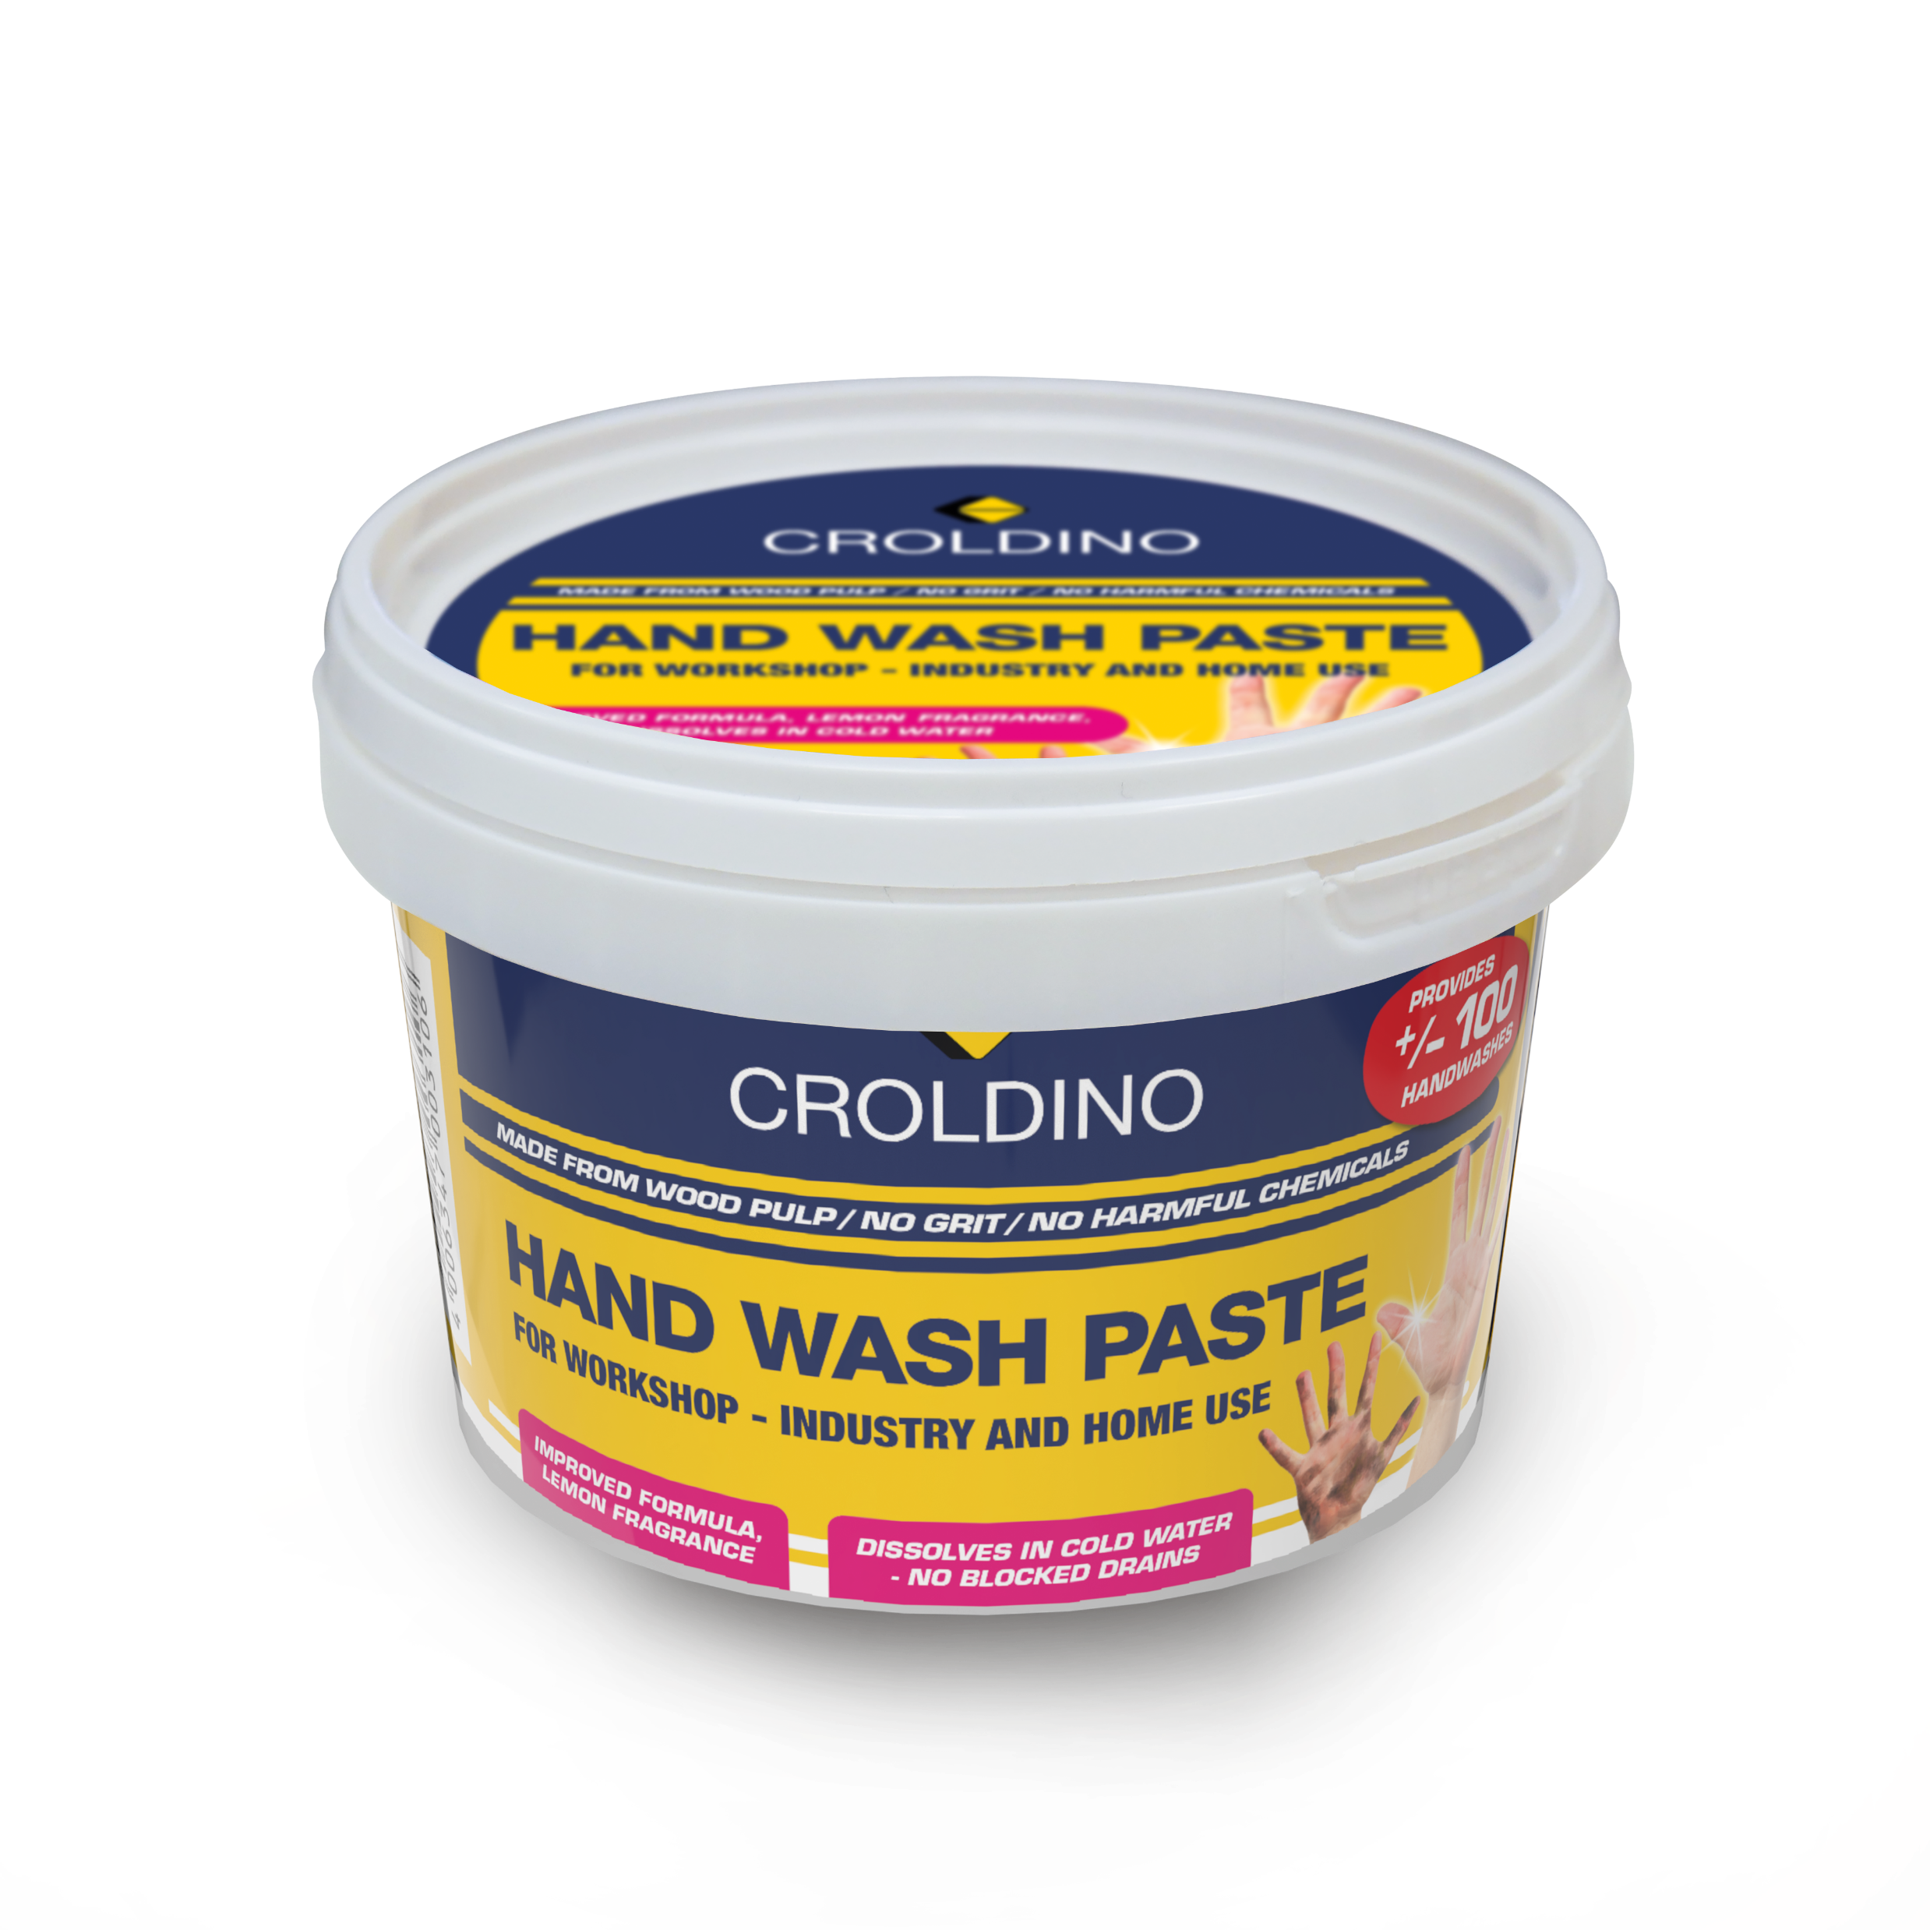
Croldino Handwash Paste
Product Information:
Especially formulated for the cleaning of heavily soiled hands in garages,
workshops, and industry
Thoroughly cleans with a balanced combination of mild, natural abrasives and
soaps The carrier is wood pulp
Easily removes oil, grease and dirt
Cares for the skin with special ingredients
pH neutral
Dermatologically tested
Completely bio-degradable
Contains no sand or petroleum jelly or aggressive chemicals
Dissolves in cold water --- no blocked drains
You only use 5ml per hand wash

Slide 33
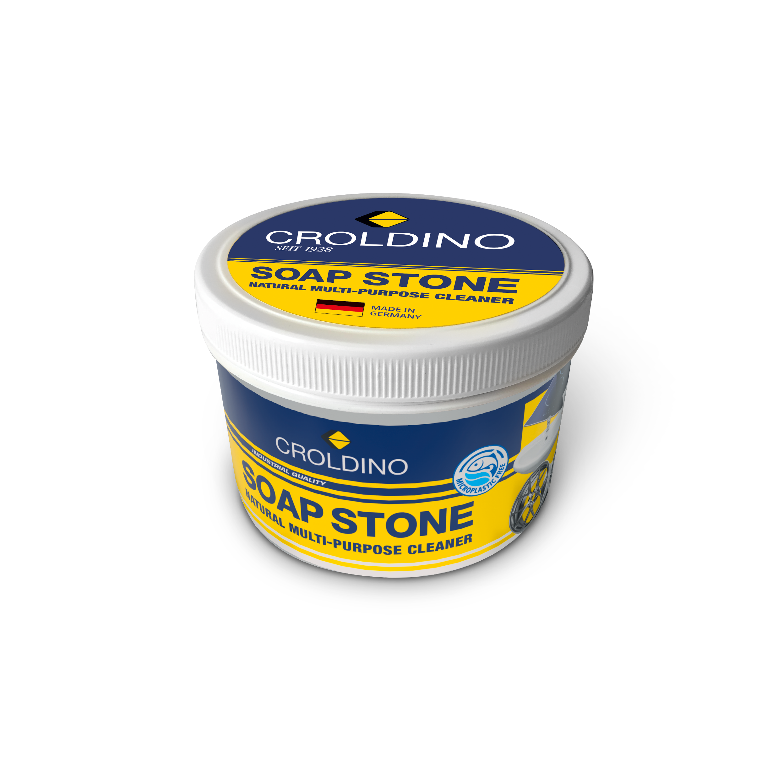
Croldino Soap Stone
Product Information:
cleans and polishes almost all surfaces
Finest aluminas achieve a particularly thorough and at the same time gentle result
unique combination of natural soaps supports the cleaning process
Can be used on all glass, plastic, painted and unpainted metal surfaces
Helps even against stubborn dirt in house, garden, workshop and car
Clean, polish, maintain and seal in one step.
bio-degradable
Not suitable for sensitive, soft surfaces

Slide 34
Thank You for your attention
Remember:
If you not sure about the product or you need technical help, give Me a call
+27827738067

